Slide 1

Neuro-Evolutional Don’t Touch the Spikes with Erlang
By: Nadav Hadad & Tamir Cohen
Advisors: Yehuda Ben-Shimol & David Leon
Course: Functional Programming in Concurrent and Distributed Systems, Ben Gurion University.

Slide 2

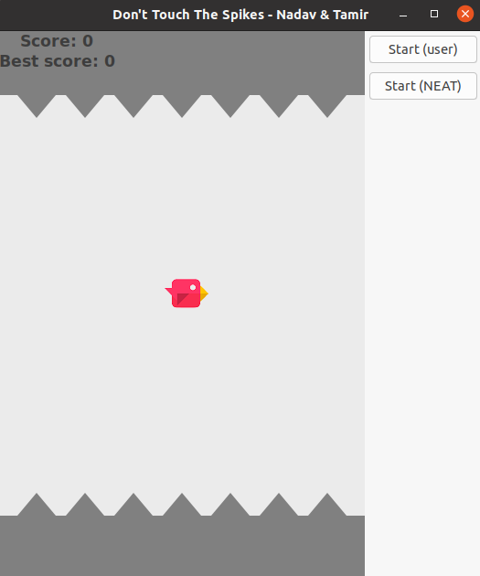
Main GUI

Slide 3

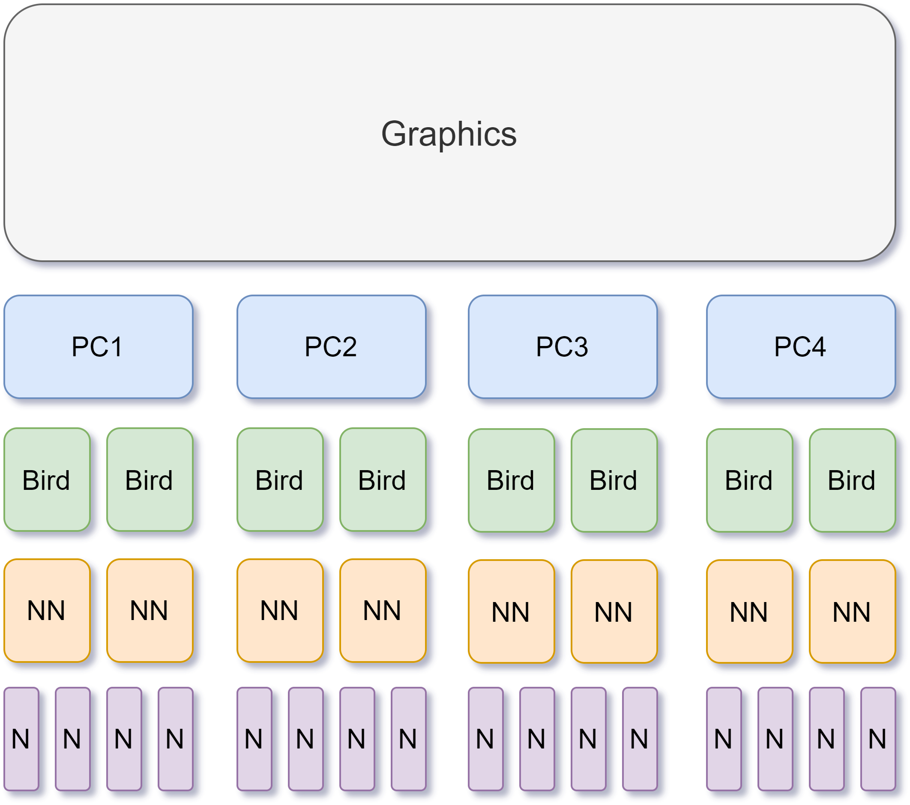
Project Layers & Design

Slide 4

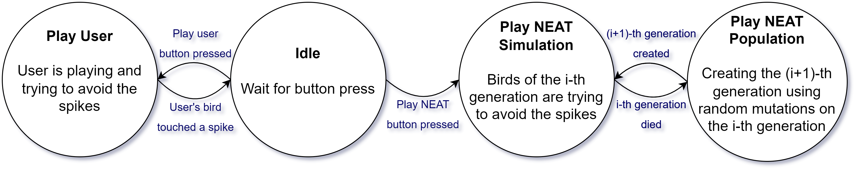
Graphics FSM

Slide 5
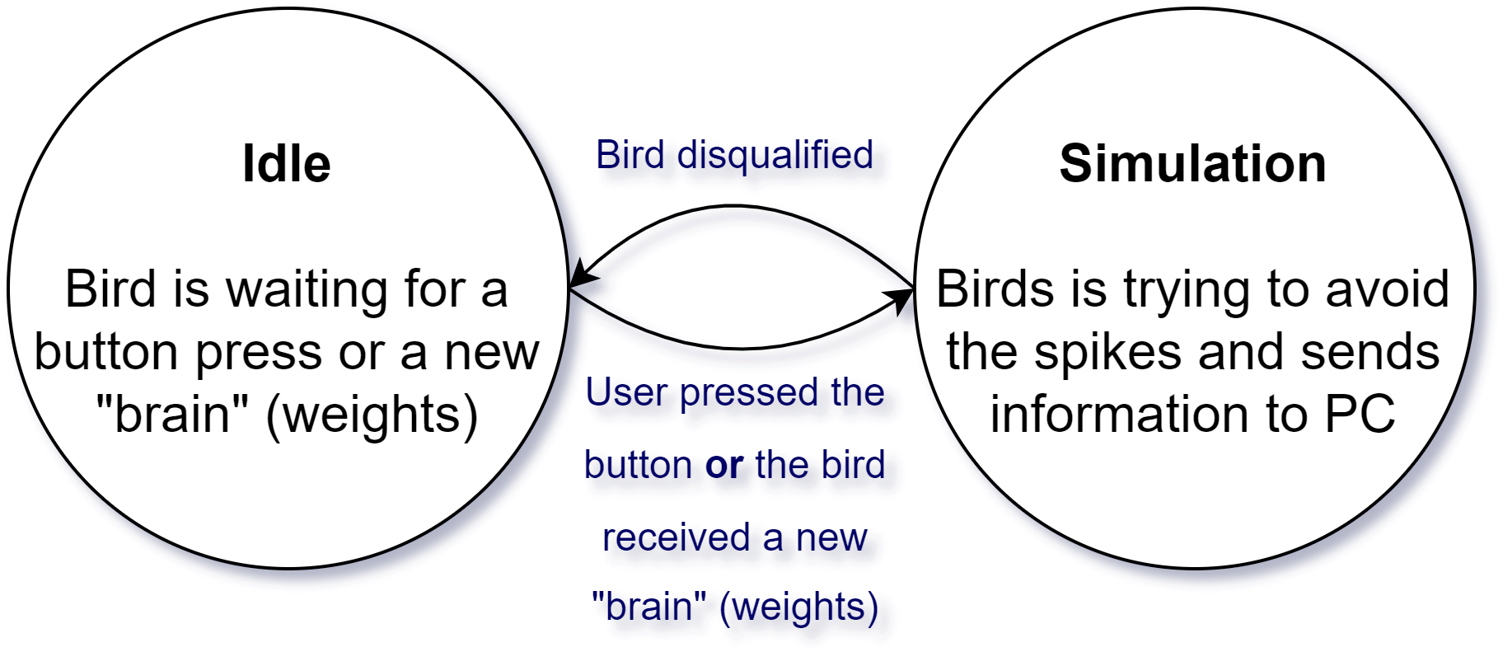
Bird FSM (User & NEAT)

Slide 6
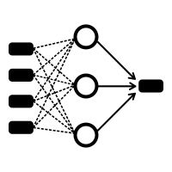
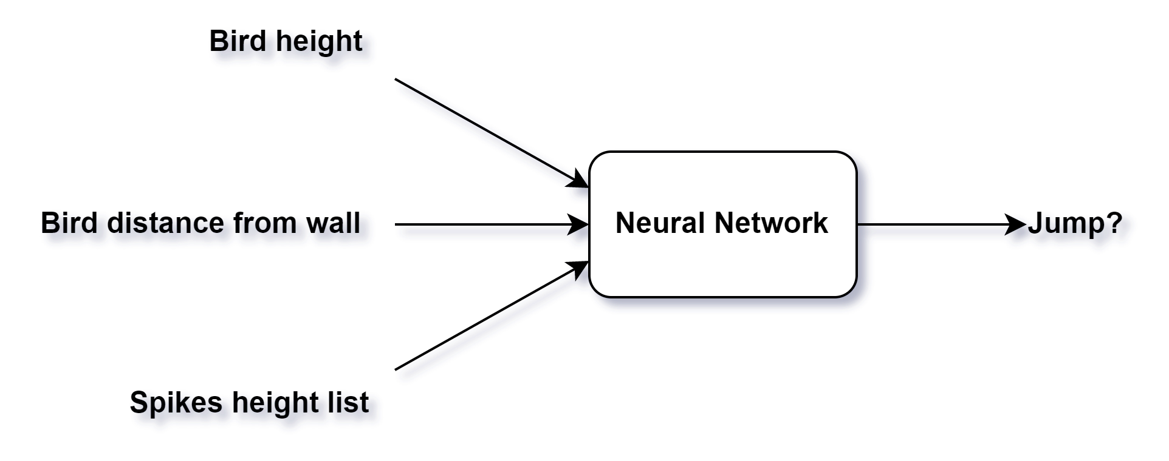
Neural Network (NN)
4 layers (11, 6, 6, 1)
tanh
20% survive

Slide 7

PC Down
- The master (the graphics module) send ‘are_you_alive’ message to all PCs every 0.5 seconds.
- each PC responds to this message with ‘im_alive’ message.
- Not getting ‘im_alive’ means the PC is down.
- The master recognize that and splits the work between the other PCs.

Slide 8

Problems
- Switch bird’s “brain” (weight list).
Each weight in the NN saved in the NN’s map. The keys of this map is the PIDs of the neurons sharing the weight. Each bird wanted to replace its brain with a better one, but how should it know which weight to put where, if the PIDs are different between different birds?
We decided to number the weights and send them to the master in the sorted order. Then, each bird receiving a brain knows exactly how to save it in its map.
- Slow system
The whole system worked slow
We decided to speed it up using few ways: sending the graphics only the Y location while the X location is synced between all, don’t ask the NN whether to jump in each frame, etc.
- Run on computer’s lab ☹.

Slide 9
Thank you for listening!

